Slide 1
Approach to Hypertension
Dr Esther Tsang
April 2011

Slide 2
Scenario 1
It is 4.59 p.m. and you are just waiting to get home. The attendant from A&E happily wheels in a patient admitted from casualty. His diagnosis was uncontrolled hypertension (as always).
The patient is 60 years old and complains of a very severe headache. His blood pressure was 220/110 mm Hg.
Do you :
A : Start an IV antihypertensive
B : Start an oral antihypertensive
C : Start an IV and oral antihypertensive

Slide 3
When do you start an IV antihypertensive?
When can you start just oral antihypertensives?

Slide 4
In this man with severe headache, if you could only examine ONE system, what would you look at?

Slide 5
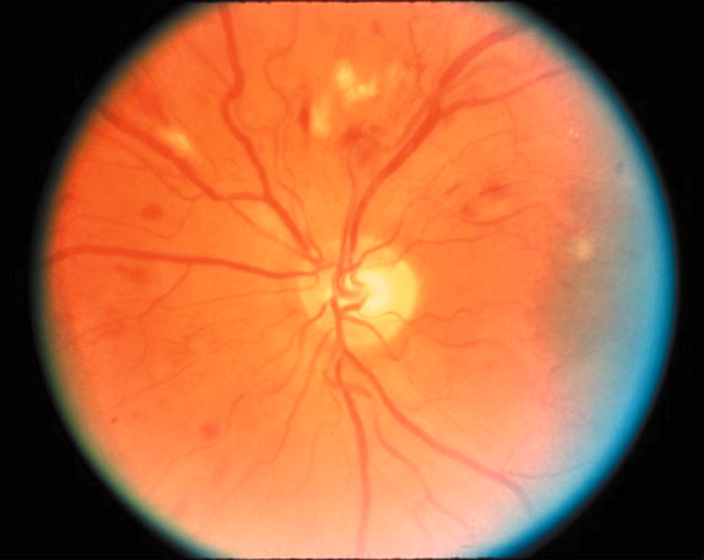
Moderate hypertensive retinopathy.
Grosso A et al. Br J Ophthalmol 2005;89:1646-1654
©2005 by BMJ Publishing Group Ltd.
Notes:
Moderate hypertensive retinopathy. Photograph shows cottonwool spots and retinal haemorrhages.

Slide 6
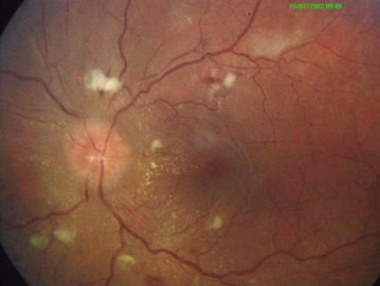

Slide 7
The houseman on call decides to leave this man alone to sleep of his headache after giving him two tablets of paracetamol.
At 3 am, staff nurse informs you that patient is breathless. You ask for a SPO2 hoping that this would delay the staff nurse for ten minutes, so that you can carry on snoozing for a while.
After hitting the snooze button a few times, nurse tells you that his SPO2 is 84%.

Slide 8
Now how? What is going on?
(You can’t call your MO or specialist, they are getting their beauty sleep with their SK II mask on, you wake them up, that would mean a couple of hundred bucks wasted AND they will so kill you….)

Slide 9
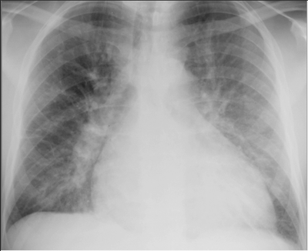

Slide 10
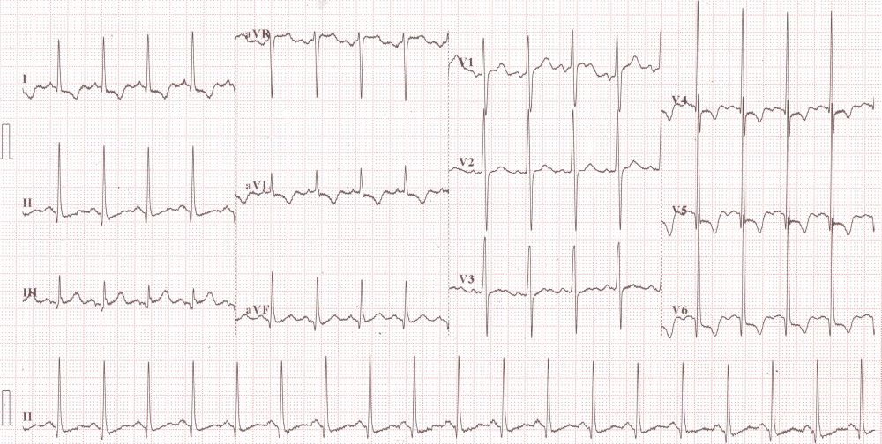

Slide 11
Which IV antihypertensive to give?
IV Labetolol
IV Isoket
What other treatment to give?

Slide 12
Then, staff nurse helpfully traces the blood results for you :
Na 135
K 5.4
Urea 23
Creat 351
Ai yo yo…. Whats this?

Slide 13
Before you can figure out what to do, he starts having a seizure…..
Now what?

Slide 14
So, what are the features of HYPERTENSIVE EMERGENCIES?

Slide 15
Scenario 2
You see a 75 year old chinese man who has the following problems :
Hypertension
Diabetes mellitus
His BP is 140/90
His Na 121/K 3.0/ urea 4.0/ creat 98
His LDL 4.0 mmol/L, TG 3.0 mmol/L
He is on Nifedipine 10mg TDS and Hydrochlorothiazide 50mg OM

Slide 16
Do you :
Continue same
Off HCTZ as BP well controlled
Add something as BP not well controlled.

Slide 17
Another patient walks in with the following problems :
Hypertension
Diabetes mellitus
IHD
Old stroke, Peripheral vascular disease, COAD
His blood pressure is 190/110 mm Hg.
He is renal profile is normal. He is on the following medications for hypertension :
Perindopril 2mg OD
Metoprolol 50mg OD
Hydrochlorothizide 12.5mg OD

Slide 18
Do you admit ward?
If you don’t, what are you going to do with his blood pressure ?
Give sublingual nifedipine 10mg stat
Add prazocin 1mg TDS
Increase Metoprolol to 100mg BD
Increase Perindopril to 4mg OD

Slide 19
A 50 year old lady with diabetes mellitus and nephropathy with hypertension is seeing you in clinic.
Her BP is 149/90.
She complains of a very irritating dry cough.
Her medications are as follows :
Enalapril 10mg OD
Amlodipine 5mg OD
Metoprolol 100mg BD
What do you do?

