Slide 1
Mr MZ

Slide 2
History
32 years old man
Fever for 4 days
Myalgia, arthralgia
Headache
Poor oral intake
Vomiting

Slide 3
What is the case definition of probable dengue?

Slide 4
Examination
T 37.9
BP 120/80 PR 88 Wt 61kg
Warm peripheries, CRT <2s
Abdomen
Mild tenderness epigastric area
CVS/Lungs/CNS – normal

Slide 5
Investigations
FBC (31/10/2010)
Wbc 4.2 (neutrophils 74.8%)
Hb 18.0
Hct 49.3%
Platelet 98
Creat 142 urea 7.7
ALT 75 AST 82
CK 197

Slide 6
Interpret the investigations results
What is the normal Hct for male and female?

Slide 7
What is your full diagnosis?

Slide 8
What would you notify as?

Slide 9
What are the warning signs in dengue?

Slide 10
What is the difference between dengue fever and dengue hemorrhagic fever?

Slide 11
How much fluid to give?

Slide 12
Management
He was given IVD (from 11am)
When to repeat FBC?
 | 31/10 9am | 11am
Wbc | 4.2 | 3.9
Hb | 18.0 | 16.9
Hct | 49.3 | 46.8
platelet | 98 | 77
Admission
OPD

Slide 13
Management
He was given IVD (from 11am)
FBC repeated as ordered
 | 31/10 9am | 11am | Rpt FBC
Wbc | 4.2 | 3.9 | 2.9
Hb | 18.0 | 16.9 | 14.5
Hct | 49.3 | 46.8 | 40.3
platelet | 98 | 77 | 86
Admission
After IVD
OPD

Slide 14
Progress (D4)
Review at 4.40pm
T 39.9 PR 100
Epigastric pain reduced
No more abdominal tenderness
Rpt FBC noted
No vomiting
Still not taking orally well
What will be your IVD regime now?

Slide 15
Progress (D4)
How frequent FBC should be done?
What are the clinical signs to monitor?
How frequent should vital signs be monitored?

Slide 16
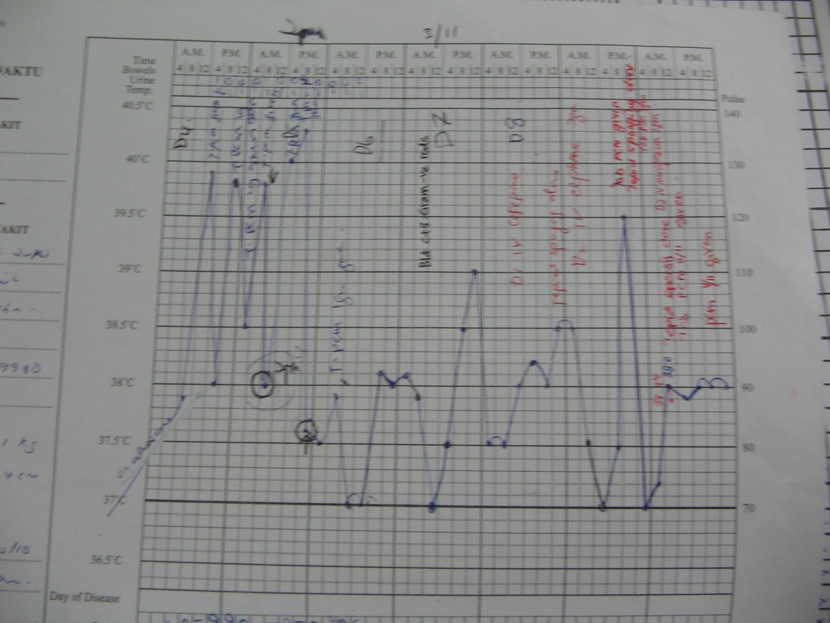
Progress (D5)
Still febrile
No vomiting
No epigastric pain
No abd tenderness
BP 110/60
PR 98, RR 18
Tongue dry
D5

Slide 17
Progress (D5)
D5
Still febrile
No vomiting
Only tolerating min fluids
No epigastric pain
No abd tenderness
BP 110/60
PR 98, RR 18
Tongue dry
 | 31/10 2pm | 1/11 6am
Wbc | 2.9 | 2.8
Hb | 14.5 | 14.8
Hct | 40.3 | 40.9
platelet | 86 | 102
8am review, how much IVD to give?

Slide 18
Progress (D5)
 | 31/10 2pm | 1/11 6am | 2pm
Wbc | 2.9 | 2.8 | 2.6
Hb | 14.5 | 14.8 | 15.8
Hct | 40.3 | 40.9 | 43.7
platelet | 86 | 102 | 34
Review patient at 3pm
Mild epigastric pain
T 38, BP 110/70
PR 98 RR 16
Good pulse volume
CRT <2s
No effusion
Mild abd tenderness now
IVD given

Slide 19
How much fluid to give?
When to repeat FBC?

Slide 20
Progress (D5)
 | 1/11 6am | 2pm | Rpt FBC
Wbc | 2.8 | 2.6 | 2.4
Hb | 14.8 | 15.8 | 15.3
Hct | 40.9 | 43.7 | 41.9
platelet | 102 | 34 | 24
Review 9pm
BP 120/70 PR 80
RR 20
Epigastric tender
Gum bleeding now
What IVD regime?
HCO3 20
After fluid resuscitation
Deferverscense

Slide 21
Progress (D5)
 | 1/11 6am | 2pm | Rpt FBC
Wbc | 2.8 | 2.6 | 2.4
Hb | 14.8 | 15.8 | 15.3
Hct | 40.9 | 43.7 | 41.9
platelet | 102 | 34 | 24
Review 9pm
BP 120/70 PR 80
RR 20
Epigastric tender
Gum bleeding now
Do you want to transfuse platelets?
HCO3 20
After fluid resuscitation
Deferverscense

Slide 22
Progress (D6)
 | 1/11 2pm | 7.30pm | 2/11 6am
Wbc | 2.6 | 2.4 | 3.4
Hb | 15.8 | 15.3 | 16.5
Hct | 43.7 | 41.9 | 45.5
platelet | 34 | 24 | 18
Review 9am
T 37.5
BP 100/60 PR 92
RR 20
Reduced breath sound both bases
IVD
deferverscense

Slide 23
Progress (D6)
What is the cause of reduced breaths sound?
How long is the deferverscence(critical) period?
What is the pathogenesis in critical period?

Slide 24
Progress (D6)
Review 4pm - T 37
BP 110/60 PR 92 good volume CRT <2s
RR 18
Reduced breath sound both bases
No epigastric tenderness
IVD 250cc/hr (5mls/kg/hr)
What to do?
 | 1/11 7.30pm | 2/11 6am | 2pm
Wbc | 2.4 | 3.4 | 3.3
Hb | 15.3 | 16.5 | 17.5
Hct | 41.9 | 45.5 | 47.1
platelet | 24 | 18 | 17
HCO3 | 20 |  | 15.1
ALT |  |  | 137
24 hours deferverscense

Slide 25
Progress (ICU) – D6
Arrived ICU 5.45pm
BP 140/70 T 37°C
PR 110 – feeble pulse, CRT >2s
RR 20
Abd – no tenderness
What is the clinical phase of disease now?

Slide 26
Management (ICU) – D6
 | 2/11 6am | 2pm | 6pm | 3/11 12am
Wbc | 3.4 | 3.3 | 4.6 | 5.6
Hb | 16.5 | 17.5 | 17.5 | 18.1
Hct | 45.5 | 47.1 | 47.7 | 48.9
Plate | 18 | 17 | 3 | 15
HCO3 |  | 15.1 | 14.5 | 14.5
IVD 1 pint NS (10mls/kg/hr) for 1 hour (6-7pm)
Then, IVD 420cc/hr (7mls/kg/hr)
Do you transfuse platelets?
Admit ICU

Slide 27
Progress (ICU) – D7
4am (3/11/10)
c/o chills
T 38.1
PR 140 BP 170/90 CRT 4s
ABG stat
ph 7.15 HCO3 9.1 95% on 3LNP
Electively intubated
Volumen 500cc, then 1 pint HM
I/O : 10678 / 2490

Slide 28
D7 illness
40 hours deferverscense
 | 2/11 6pm | 3/11 12am | 4am | 6am
Wbc | 4.6 | 5.6 |  | 4.1
Hb | 17.5 | 18.1 |  | 12.6
Hct | 47.7 | 48.9 | 31 | 36.3
platelet | 3 | 15 |  | 6
HCO3 | 14.5 | 14.5 | 9.1 | 19.2
Lactate | 1.1 | 1.6 | 11.3 | 2.2
Intubated
COMMENT ON THE HEMATOCRIT TREND

Slide 29
What has happened?
What would you do now?

Slide 30
D7 illness
48 hours deferverscense at 2pm
 | 3/11 6am | 8am | 12pm
Wbc | 4.1 | 7.8 | 6.0
Hb | 12.6 | 16.4 | 14.9
Hct | 36.3 | 46.6 | 42.3
platelet | 6 | 14 | 8
HCO3 | 19.2 | 18.3 | 14.9
Lactate | 2.2 | 1.9 | 1.3
Your management

Slide 31
D8 illness
 | 3/11 4pm | 4/11 12am | 6am | 12pm | 6pm
Wbc | 7.8 | 10.8 | 12.2 | 11.4 | 13.7
Hb | 18.3 | 17.9 | 17.0 | 18.2 | 16.6
Hct | 52.7 | 50.8 | 48.8 | 51.0 | 47.1
platelet | 11 | 27 | 35 | 30 | 53
HCO3 | 16.4 | 13.3 | 15.2 | 15.1 | 17.6
Lactate | 2.0 | 1.7 | 1.4 | 1.7 | 1.5
48 hrs deferverscense
IV Lasix 20mg
IV lasix 20mg
FIO2 0.6
IV Noradr started 6pm

Slide 32
Progress – D8 to D14
IV Cefepime started for VAP
CXR not improving
Temperature still spiking
Noradrenaline started
Changed to IV meropenem as not improving
BC no growth
De-escalate to IV Cefepime (total Ab 7 days)
Extubated D 13 illness
Transfer to dengue ward D14

Slide 33
D9 to D15
 | 5/11 | 6/11 | 7/11 | 8/11 | 9/11 | 10/11 | 11/11
Wbc | 13.5 | 5.9 | 7.4 | 8.6 | 9.1 | 9.6 | 9.1
Hb | 15.9 | 15.9 | 13.9 | 11.9 | 12.9 | 13.5 | 13.1
Hct | 45.3 | 44.7 | 39.7 | 35.3 | 38.7 | 40.5 | 39.4
Plat | 74 | 83 | 70 | 99 | 129 | 150 | 163

Slide 34
Patient discharged home well

