Slide 1
Approach to Coma
Dr Esther Tsang
Sept 2011

Slide 2
Case 1
80 Chinese gentleman
Brought in unconscious, found at the side of the road
Appears dirty, unwashed; smelly
No witnesses or family traced
What are the possible causes of coma in this gentleman?

Slide 3
What does GCS stand for?
How do you assess the GCS?
What is the minimum and maximum score?
Describe how you would assess for pain response?

Slide 4
His GCS was M4V3E2
He was noted to be moving his right UL and LL but not his left.
What are your thoughts?

Slide 5
What other vital signs would you like to observe for?
What physical signs are useful in the assessment of this gentleman?

Slide 6
You note that his pupils are equal and reactive. What does this mean?
His left UL and LL was of normal tone and he has a power of at least 3/5. How would you assess power in a patient who is unable to obey commands?
Reflexes on the left side was normal with a downward plantar response.
His right UL and LL was hypotonic, hyporeflexic and plantars was equivocal.

Slide 7
How do you interpret these physical signs?
What are the physical signs in an upper motor neuron lesion and in a lower motor neuron lesion?

Slide 8
His BP was 180/100 mm Hg.
T 39°C HR 110bpm Sp02 90%
Pulse was irregular.
CVS PSM over apical region, grade 3. Apex beat displaced to 6th intercostal space, anterior axillary line.
Lungs crepitations up to right mid zone.
Abdomen normal.
Explain his physical signs.

Slide 9
What is your working diagnosis?
What investigations would you request for?
Interpret the following investigations.

Slide 10
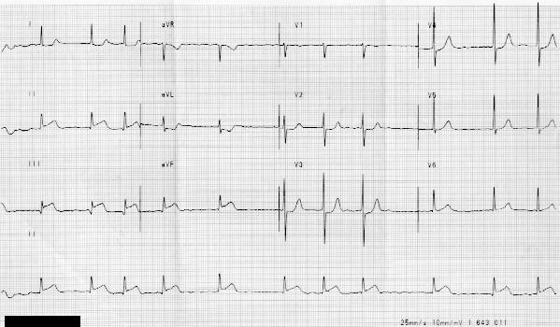

Slide 11
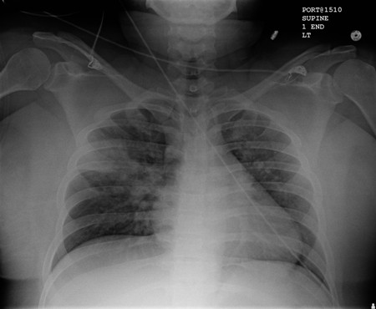

Slide 12
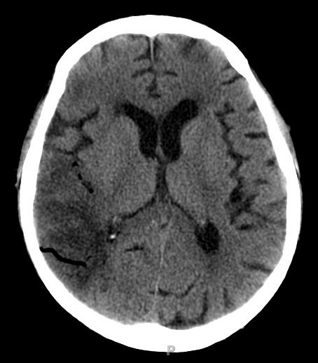

Slide 13
How would you manage this patient? (in detail)

Slide 14
Case 2
45 year old Chinese lady brought in confused with reduced consciousness.
Had diabetes mellitus diagnosed 4 years ago but not seeing the doctor. Buying medications on own.
Medications : Glibenclamide 10mg OD, Metformin 1g BD.
Had feet swelling for the past 4 months, felt lethargic.
Mild breathlessness past 2 weeks.
Poor oral intake past 1 month.
Brought in by daughter.

Slide 15
What are the possible causes of her reduced GCS and confusional state?
What bedside test must be done immediately?

Slide 16
You examine her and find the following :
BP 140/80 mm Hg
HR 110pbm
T 38°C
Reflomet 3.0mmol/L
GCS : M5V4E3
What other systems would you want to examine and why?

Slide 17
Her Sp02 was 96% on air
Lungs crepitations over bilateral lower zones, with more crepitations over right lung up to mid zone – coarse
Pedal oedema up to knee
Acidotic breathing.
Explain the physical signs.
What is your working diagnosis now?

Slide 18
What investigations would you like to perform?
How would you manage this patient?

Slide 19
Summarize the causes of low GCS.

