Slide 1
GenSurg App
Basic tutorial for discharge summary
Medical Department
Hospital Pulau Pinang

Slide 2
Creating Patient’s Information
Run GenSurg App on desktop
Log in with username and password (default password: medical)
Change your new password

Slide 3
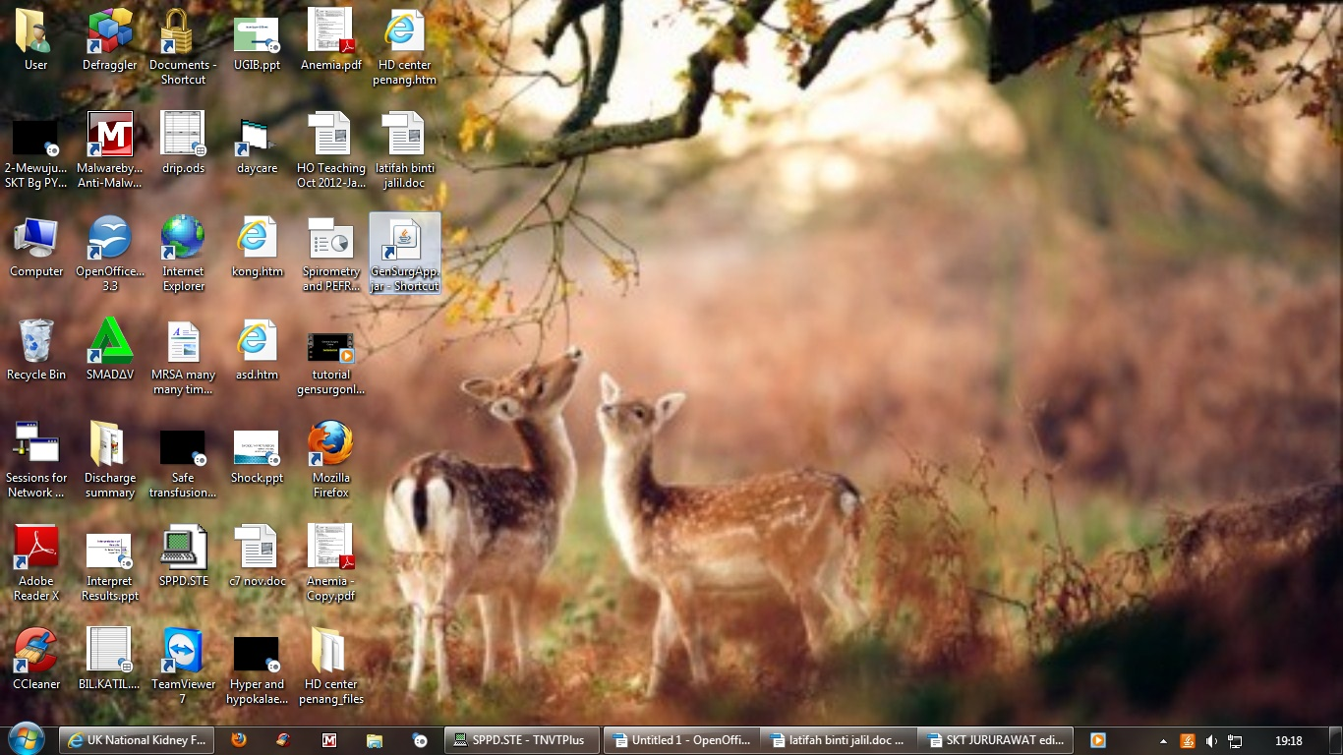

Slide 4
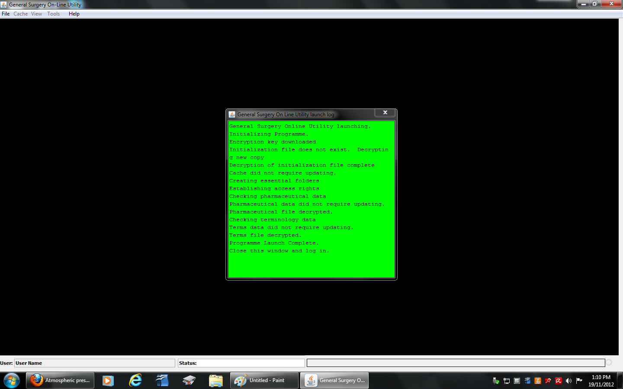

Slide 6
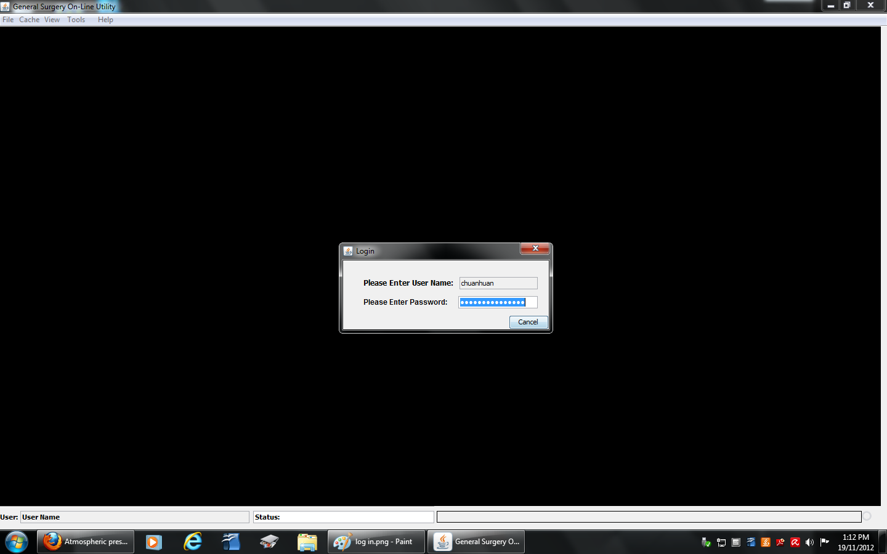

Slide 8
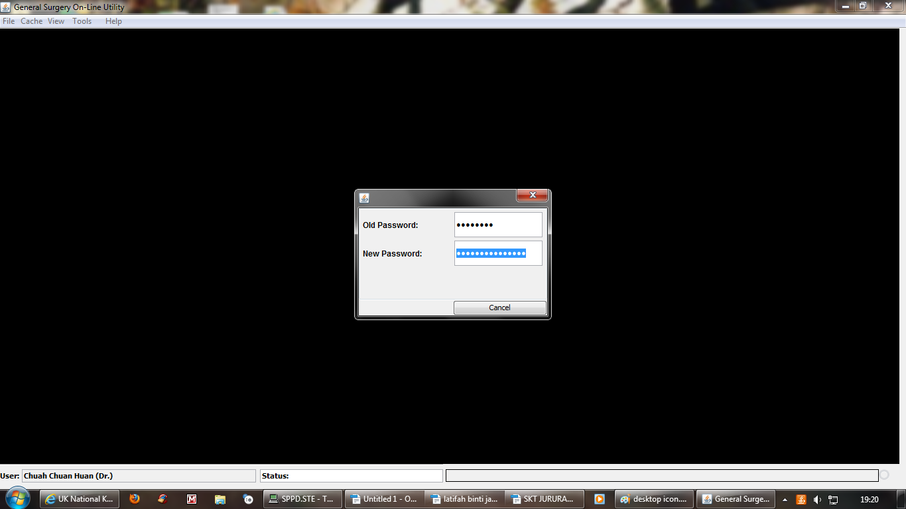

Slide 9
ADD New Patients
Click ‘New’ for new patient
Fill in patient’s Basic Information:
Name
IC
Gender
Ethnic,
Marital Status,
First Seen Date
Discharge Date
Department
Click ‘Save’

Slide 10
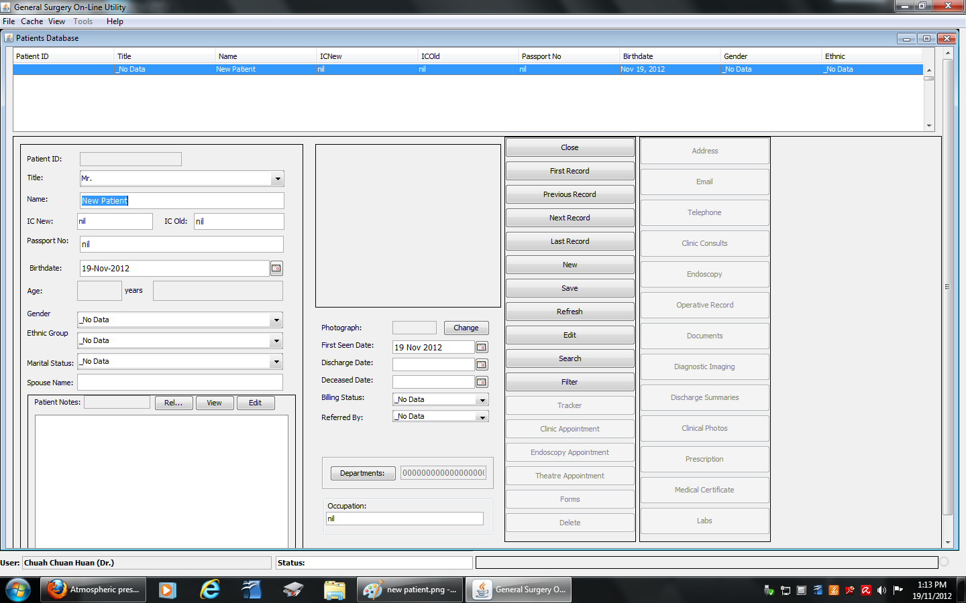

Slide 11
Click on the patient’s name above
Fill in patient’s Telephone, Address and Lab results
Click ‘New’ in each sections to create new data

Slide 12
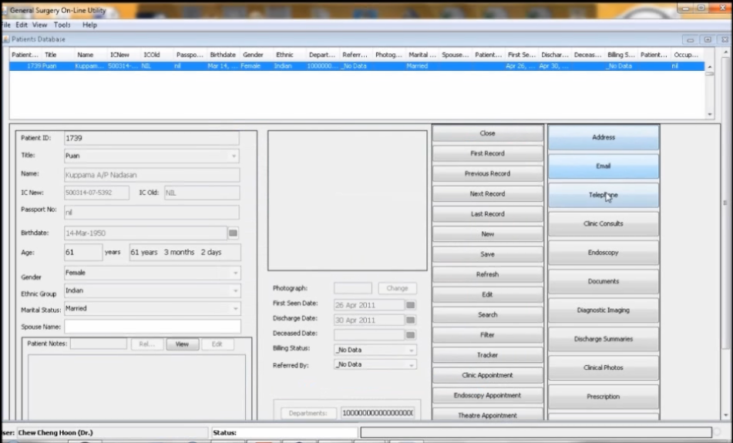

Slide 13
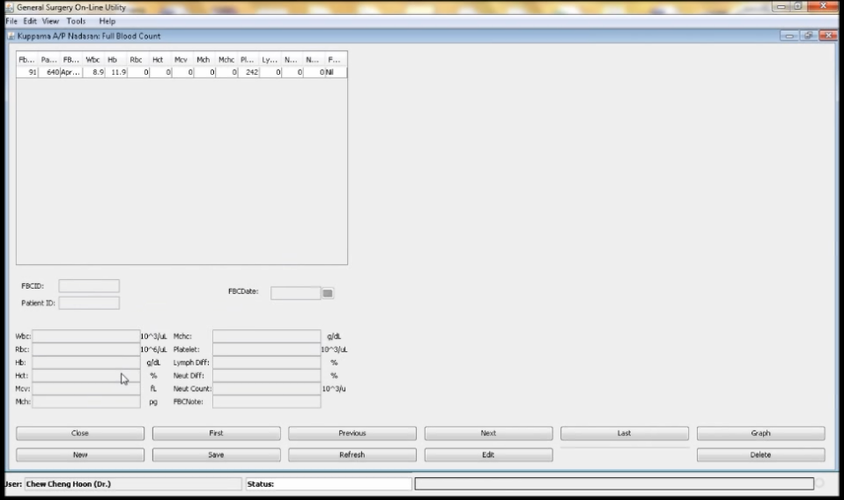

Slide 14
Searching for a Patient
Click ‘Search’
Key in either:
Patient’s name
IC
RN
Select the name from the list and click ‘OK’

Slide 16
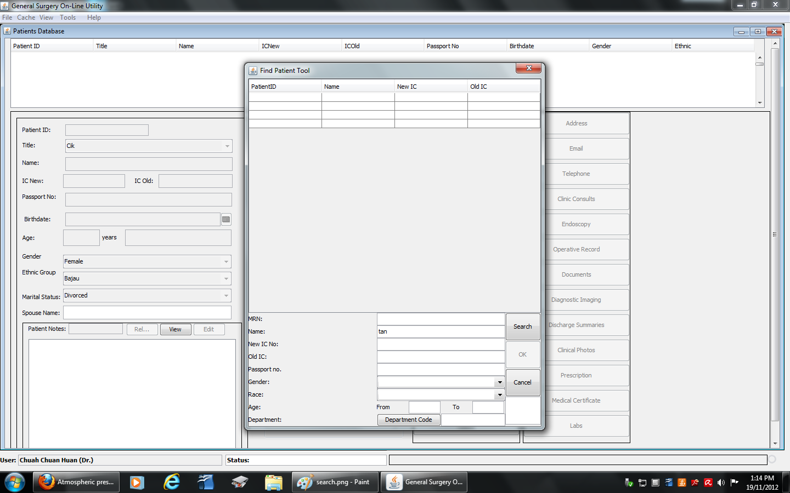

Slide 17
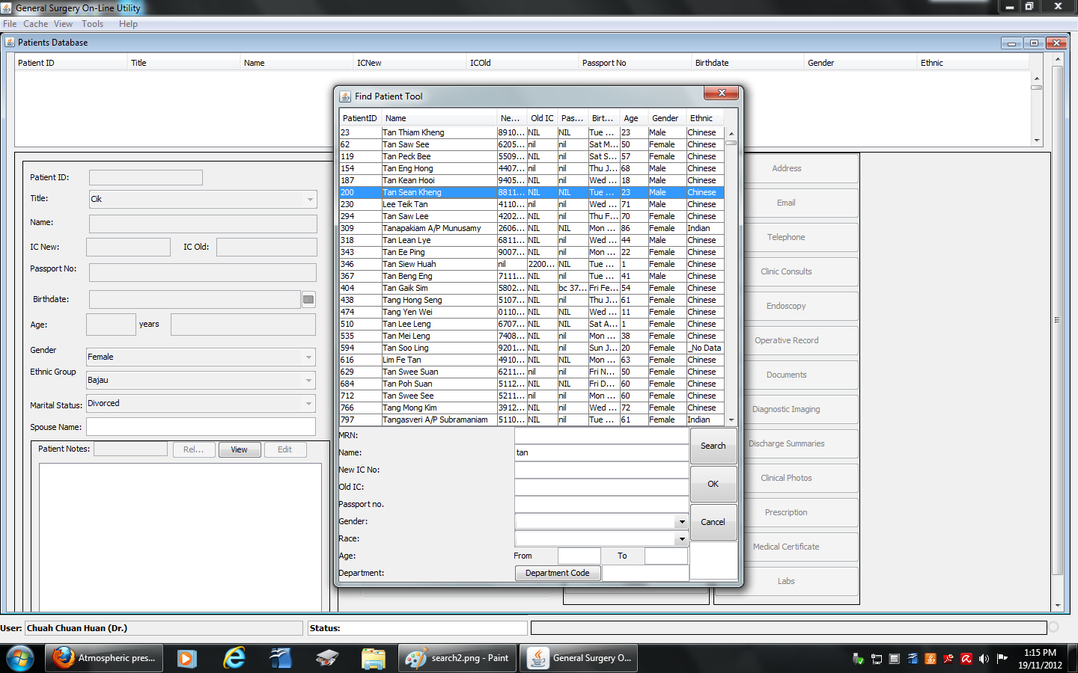

Slide 18
CREATING A Discharge Summary
Click ‘Discharge Summary’
Click on “NEW” then type in the patient’s summary
Insert Laboratory results
Click ‘Save Document’
Insert Patient’s current admission data, including admission dates, RN, ward, ICD10
Sign Off with password
Print with size A5

Slide 21
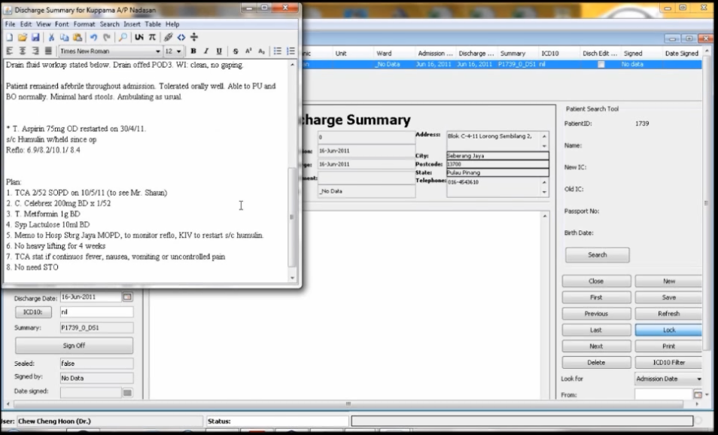

Slide 22
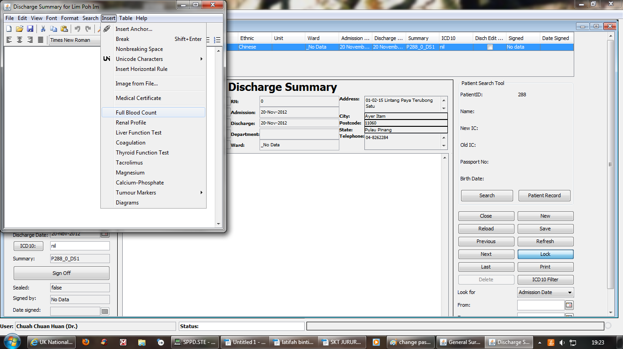

Slide 23
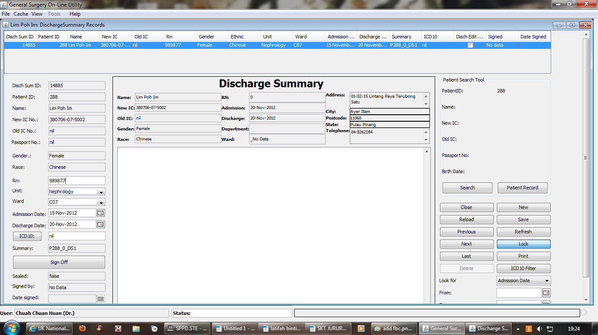

Slide 25
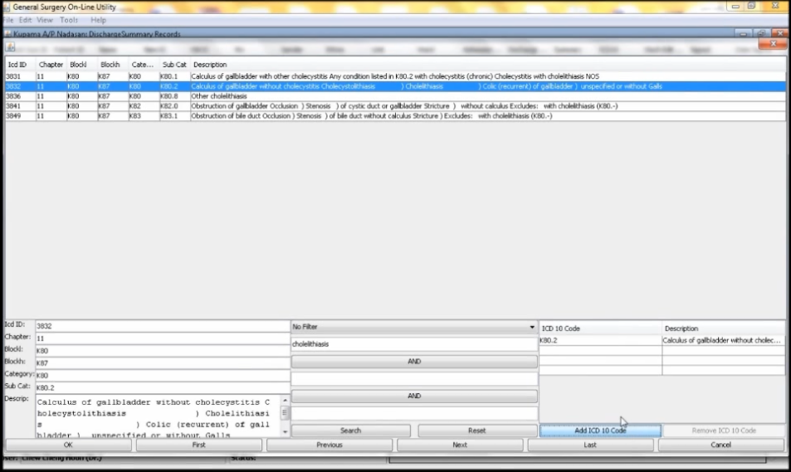

Slide 26
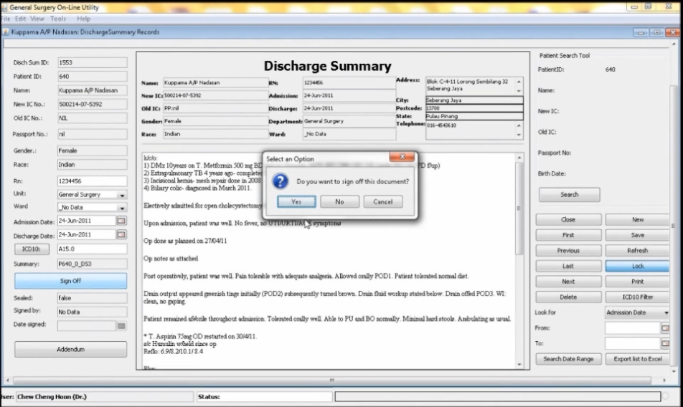

Slide 27
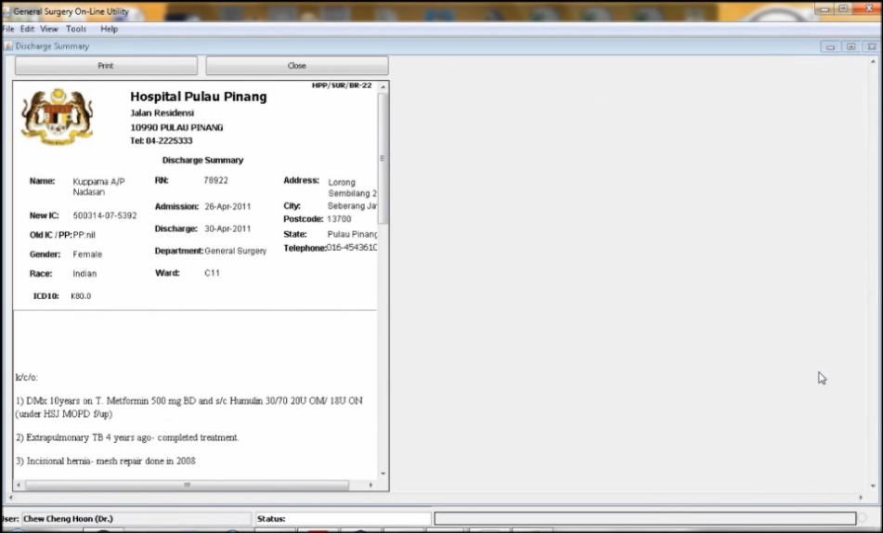

Slide 28
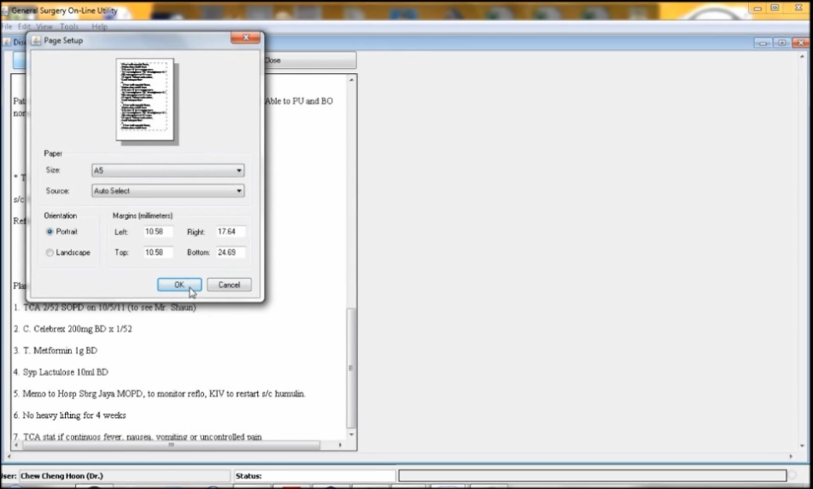
Use size A5
(Cut A4 size papers into half)

Slide 29
Thank You

